Slide 1

Reverse Hypothesis
By:
M.Logeswari

Slide 2
I have done a reverse hypothesis test for Dabur red toothpaste
DADUR RED TOOTHPASTE

Slide 3
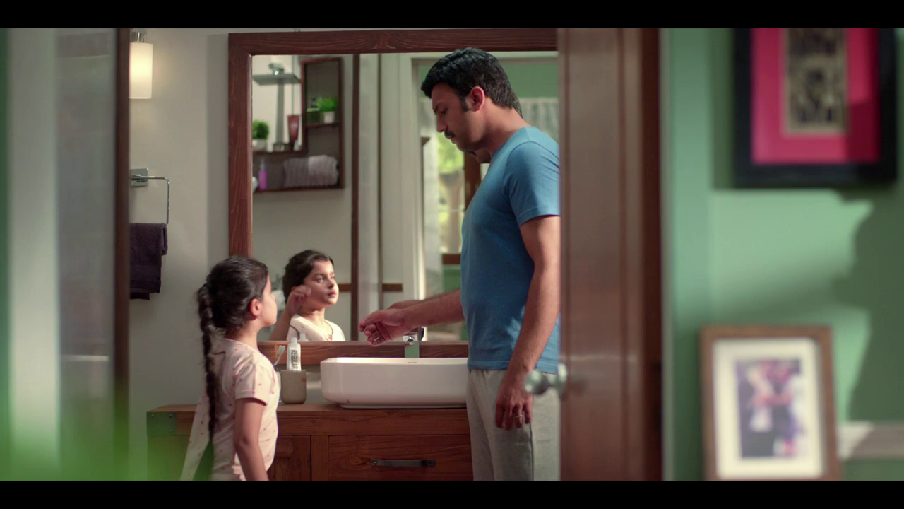
Dabur Red Toothpaste

Slide 4
Product sold
Bachelors | Family
113 | 45
76 | 135
56 | 86
126 | 76
155 | 145
80 | 156
99 | 99
105 | 126
167 | 79
66 | 87
 | A | B | C
Yellow | 10 | 20 | 7
Blue | 30 | 15 | 10
Orange | 5 | 24 | 16

Slide 5
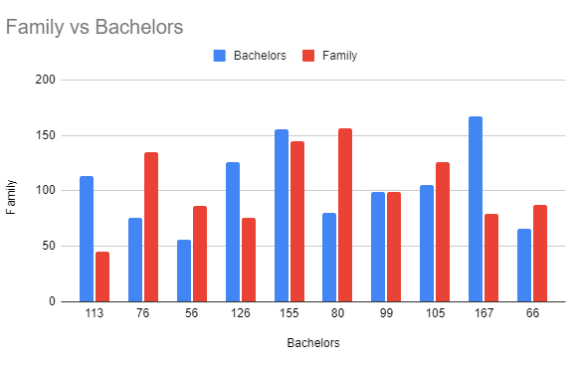
Visualization
.

Slide 6
Hypothesis Test
y = No. of product sold (Continous)
x = Bachelor & Family (Discrete)
alpha = 0.05
Test - 2 sample t test
p = 0.9563
p > alpha (p is high)
Null Hypothesis is accepted

Slide 7

Conclusion
Thus we conclude there is no difference between the product purchased by the bachelor and family.
The product reach is equal to the both of them.
Generally the society focus on the family so the our ad is based on family to impress the people.

Slide 8

Thank you!
Any questions?

